Slide 1
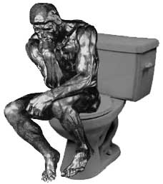

Slide 2
Pretoria

Slide 3
Tantalum

Slide 4
Elop -> null

Slide 5
Clojure Android?

Slide 6
Scala Android?

Slide 7
C# Android?
JS Android?
TypeScript Android?
C? D? F#?

Slide 8
Java!

Slide 9
Java!
RX?

Slide 10
Java!
RX?

Slide 11
Java!
Functional
Reactive
Lambdas
Async
Transparent
Performance
-> All new,
better
Tantalum

Slide 12
Performance Psychology: To increase developer performance..
Decrease Code Errors
Fail fast
Explicit threading at object creation, not invocation
Pure function trees
Only leaf nodes have side effects
Decrease Tangential Work
Minimize boilerplate
Provide in-flow system testing
Focus on algorithm, not plumbing
Concurrent reactive data structures
Increase Code Insight
Distributed algorithm transparency
Explicit pre-conditions
Show and annotate the origin in _your_ code of any messages
Flat lambda-passing for less hierarchy

Slide 13
Performance Information Logistics: To increase runtime performance..
Decrease Work In Progress (WIP)
WIP = Partially finished goods
Depth-first task tree traversal
Path-independent optimization of convergence on eventually consistent end state
Increase resource utilization rate
Eliminate blocking using explicit dependency chains
Tuned thread pools for
Common work backlog
Optimal concurrency
Minimum peak memory load

Slide 14
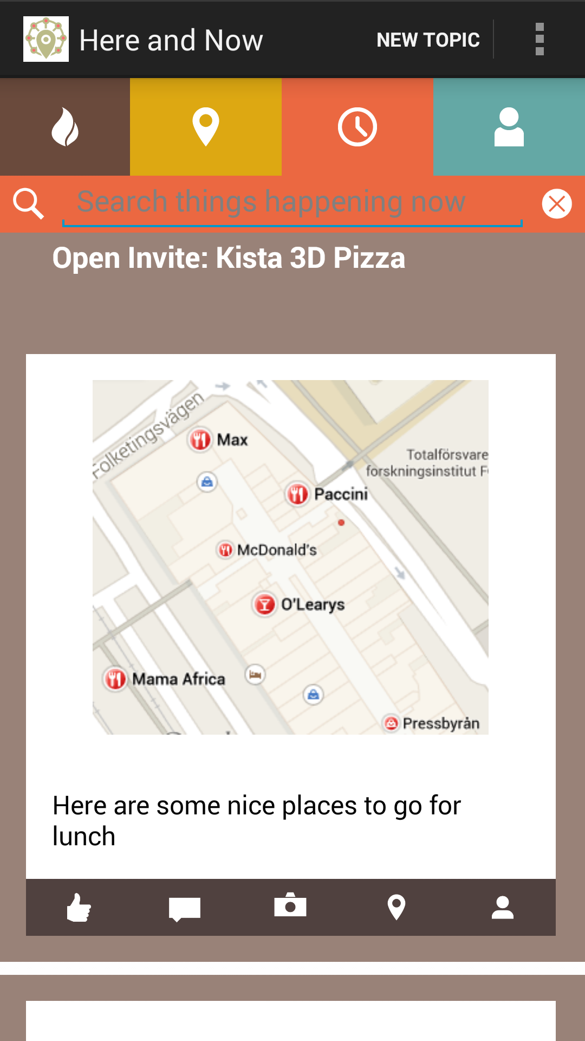


Slide 15
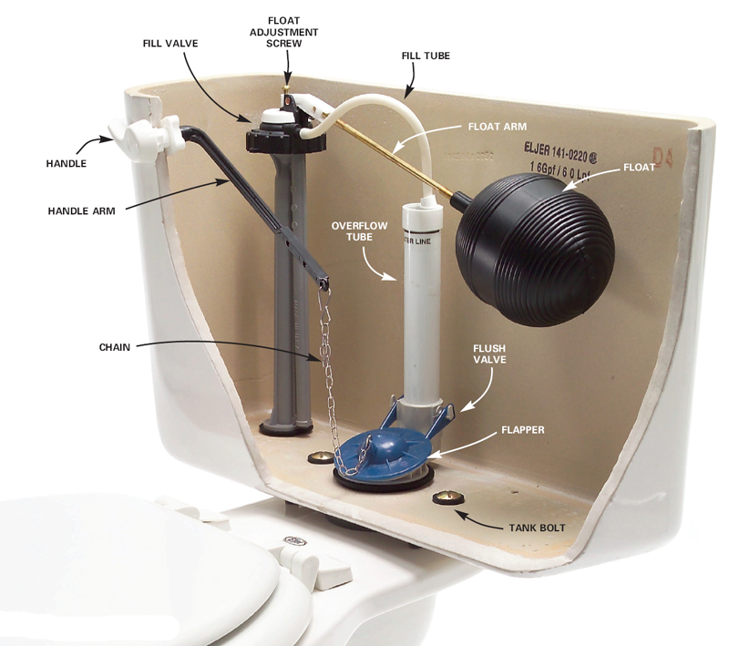

Slide 16
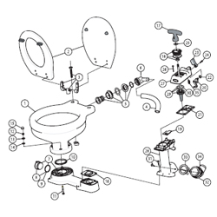
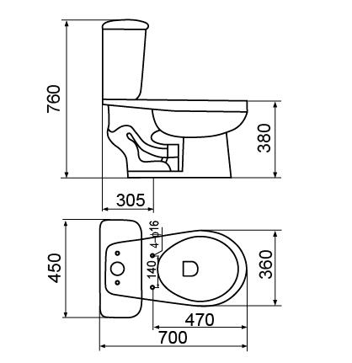
Kit 1
Kit 2
Connect plumbing for each use
Disconnect and clean after each use
Everyone uses it
Assembled: one step install
Self-cleaning
Experimental, open to improvement

Slide 17
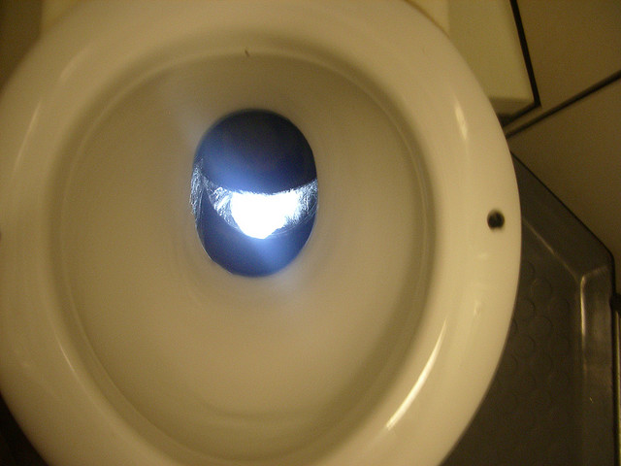
What you really want: zero config Kit 3 “works like a train toilet”

Slide 18

Cargo Cult Development
Are you driven to make rugged and reliable machines?

Slide 19
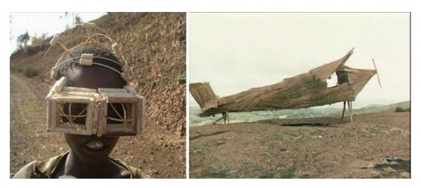
.. or Cargo Cult Development

Slide 20

.. or Cargo Cult Development

Slide 21
“You cannot make a man by standing a sheep on its hind legs. But by standing a flock of sheep in that position you can make a crowd of men.”
-Max Beerbohm

Slide 22
“You cannot make a man by standing a sheep on its hind legs. But by standing a flock of sheep in that position you can make a crowd of men.”
-Max Beerbohm
-> Typical open source library that throws useless stack dumps at you

Slide 23


Slide 24
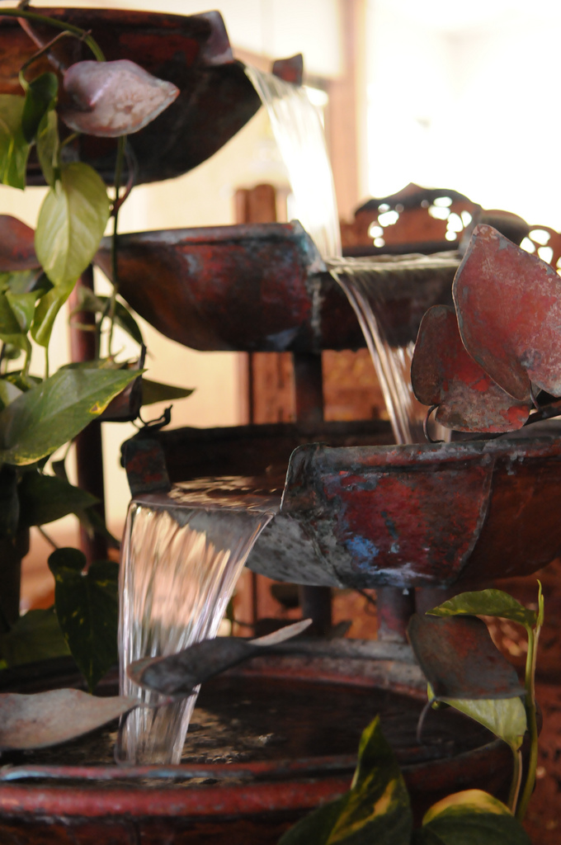
Reactive Cascade
Q: Ask Why
A: Quickly develop reliable, high performance Android apps

Slide 25
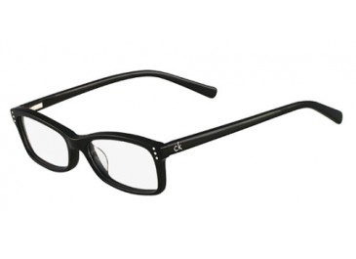
The driver: Great UX
(skip interface designer blah blah here)
Developer: architecture details ->
Speed
Trust contract with the user
Implicitly non-blocking
Deeply event driven

Slide 26
The driver: Great UX
Developer: architecture details ->
Speed
- start time, close time, persistent initial display state
- subjective speed (UI) prioritization, bend time and space, throttle peak contention
- after the visible: high core throughput decreases user-perceptible delays, power use
Trust contract with the user
Implicitly non-blocking
Deeply event driven

Slide 27
The driver: Great UX
Developer: architecture details ->
Speed
Trust contract with the user
- contract: demons in your phone accept a task. And always do it
- orderly behavior when things go wrong
Implicitly non-blocking
Deeply event driven

Slide 28
The driver: Great UX
Developer: architecture details ->
Speed
Trust contract with the user
Implicitly non-blocking
- There is a correct thread for everything, and no more
how are you bound? CPU, flash read, flash write, network (dynamic concurrency by available bandwidth)
- Minimal resource usage (concurrent memory use window, concurrent peak, write behind of needed)
Deeply event driven

Slide 29
The driver: Great UX
Developer: architecture details ->
Speed
Trust contract with the user
Implicitly non-blocking
Deeply event driven
- minimal timer loops, throttling and back pressure
- do things I can see first, the reset whenever (async)

Slide 30
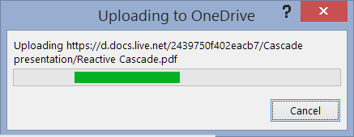
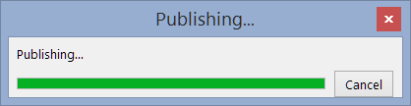
Great UX?
Publish PDF ->
Create PDF is fast
But you can’t do anything until the net upload finishes (slowly)
It then opens a _new_ copy of a webpage (every time, no choice)
That forwards
That forwards
That _downloads_ and shows an web copy of the PDF I published
That I do not want. I’m just exporting a PDF to my hard drive

Slide 31
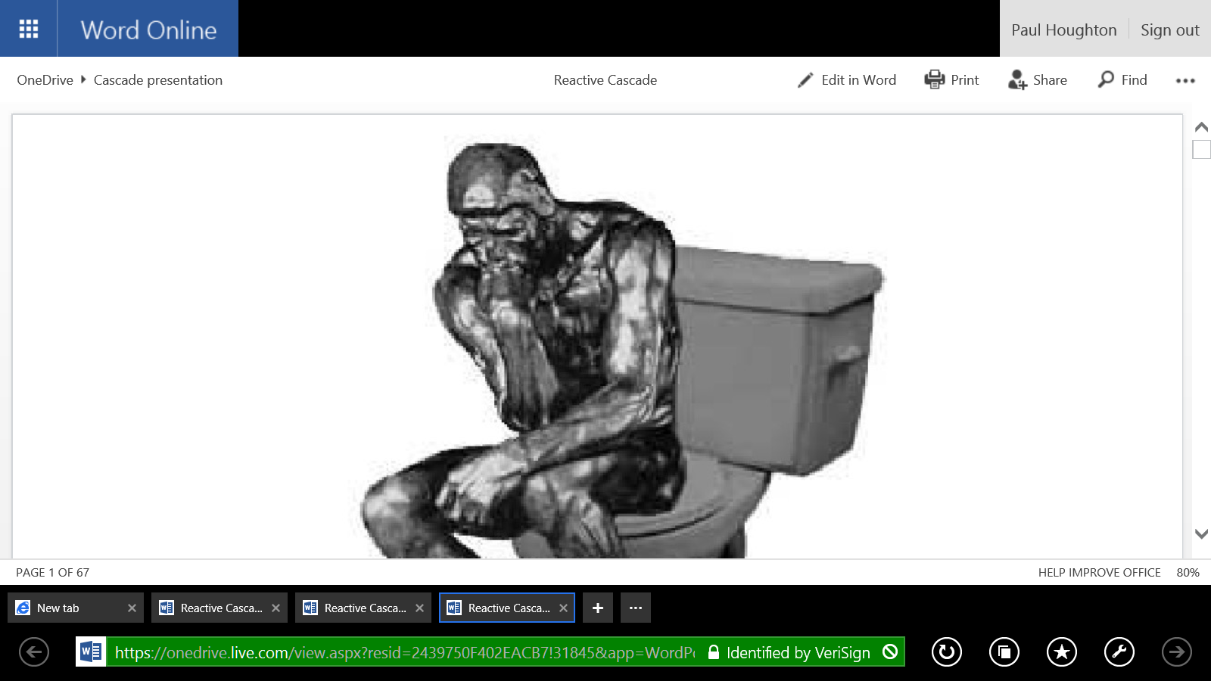

Slide 33
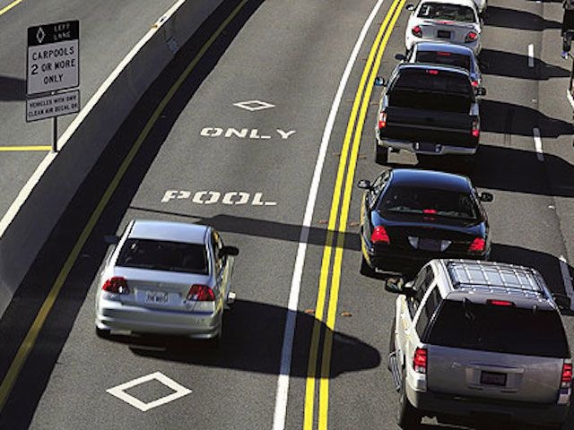

Slide 34


Slide 35
UI
WORKER

Slide 36
NET WRITE
NET READ

Slide 37
FLASH WRITE
FLASH READ

Slide 38
Great Developer Experience (DX)
Self-validating objects catch and help solve common errors early
Optimal concurrency is automatic
Strong threading model driven by the _creator_ of a object, not the _caller_
Errors are handled sequentially like other functional and reactive chains
Zero config and near zero boilerplate
Your properly threaded algorithm show clearly in one place
Good defaults are deeply replicable
Aquarium transparency means you know what is going on
Lambdas: all code for a sequence of operations is visible in one place
Warnings and errors tell you what you probably need to do
Warning and error provide a convenient link to the _most likely cause_ of the error, not just a cryptic result

Slide 39
Cascade is Functional and Reactive
Functional
Reactive
Fire once -> immutable
Strongly typed .then() chains
Λ-friendly functional interfaces.then() to compose a chain
-> immutable value object (VO) after .fork() and successful run
.cancel() or exception -> immutable
Example: ImmutableValue<String> s
s.then(value -> println(value));
Variable changes -> fire sequence
Compiled synchronous exec
unless you change thread group
.subscribe() and .unsubscribe()
Automatic unsubscribe when all subscribers are gc()ed
Tail held tree with weak forward reference
Example: AtomicValue<String> s
s.subscribe(val -> println(val));
-> Use the right tool for the job -> what makes most sense to you

Slide 40
Functional Example
ImmutableValue<Integer> count = new ImmutableValue<>();
// I don’t yet know the value
// I do know what I want to do when the value is determined
count.then(value ->
println(“The count is “ + value));
..
count.set(34);
// Triggers one time logic run
// Count is now an immutable value object
// Clean for further functional use
The point: throw logic around – it can safely happen concurrently on any thread

Slide 41
Functional Example
SettableAltFuture<Integer> count = new SettableAltFuture<>(WORKER);
count.then(value ->
recalculateSheetOne(value); // CORE 1
count.then(value ->
recalculateSheetTwo(value); // CORE 2
count.then(UI, value ->
println(“The count is “ + value)) // CORE 3
..
count.set(34);
Atomic operation from any thread triggers transform to immutable value object
Three down-chain actions run concurrently on the UI and two worker threads

Slide 42
Functional Example
NET_READ.then(() ->
return getMessagesServer())
.then(WORKER, (raw) -> {
return parseMessages(raw))
}
.then(NET_WRITE, (MyDataType parsedList) -> {
storeToFlash(parsedList);
}
.then(UI, (MyDataType parsedList) -> {
display(result))
}
.onError(() ->
popupError(“Stopped at count “ + count.get());

Slide 43
Reactive Concurrent Example
AtomicValue<Integer> incidentAngle = new AtomicValue<>(WORKER, “Item length”);
count.subscribe(UI, value -> {
println(“The length is “ + value) // CORE 1, main thread
}
.subscribe(degrees -> {
viewModel.updateAngle(degrees) // CORE 2, concurrent background
}
.subscribe(value -> {
return mapValue(value); // CORE 3, concurrent background
}
.subscribe(value -> {
mappedSum::increment); // AFTER CORE 3, sequential
..
// From any thread
count.set(34);
// Cascade of concurrent downchain actions on each set

Slide 44
Reactive Concurrent Example
AtomicValue<Integer> count = new AtomicValue<>(WORKER);
count.subscribe(value ->
recalculateSheetOne(value);
count.subscribe(value ->
recalculateSheetTwo(value);
count.subscribe(UI, value ->
println(“The count is “ + value))
..
count.set(34);
Atomic operation from any thread triggers state variable change
Three down-chain actions run concurrently on the UI and two worker threads
.. every time the state changes

Slide 45
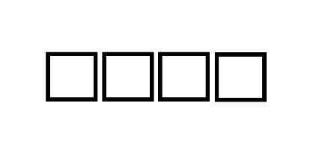
Two Classic Threading Approaches
Single Thread
Logically easy
Component steps don’t need concurrent design
Slow as fuck
Unlimited or “automatic” thread pool
Logically easy, not my concern
Unlimited concurrency
Context switch and resource use
Probably faster, but still slow fuck
.. And “out of memory”

Slide 46
Why not use Futures with One Thread?
A very short story
Object A is not yet done
Your one thread calls A.get()
Deadlock
Moral: if threads block, you need an unlimited number of threads

Slide 47
Future vs AltFuture
Future
AltFuture
Runs on any thread
Blocks any thread at .get()
Max concurrency not addressed
Too few threads -> deadlock
Too many -> mem and CPU bog
Complex Exception handling
Thread group specified at creation
UI, WORKER, NET_READ, FLASH_WRITE
Max concurrency contract
Start order is FIFO..
..then LIFO once a chain starts
.onError(Exception) composition
_entire_ down-chain is notified

Slide 48
Tuned Thread Pools -> Heat Up The Phone
Single Queue per constraining resource
Call each of these resource-defined queue+thread pool+tools an “aspect”
Logically easy
“Just right” concurrency for performance
Other categories like network, flash read/write also fight for CPU, but…
They use very little CPU, they use other chips in the phone
So these additional threads can be concurrent and “free speed” to the CPU

Slide 49
How do we make concurrent easy?
Atomic + Functional
Very visible
heavily instrumented, runtime assertion checks, live graphic visualization, descriptive error messages, named objects and messages for readability, origin tracking and stack trace parsing
Atomic value objects are written for you
Concurrent reactive collections are written for you
Dependencies are explicit in the chain
Each object knows where to run and when to be concurrent or not
You can hint if you want to override the default “continue on same Aspect”
Resources use is constrained by FIFO aspect throttles
And LIFO chain completion before starting new chains
Only if LIFO is allowed (not an in-order-execution Aspect)
Automatic reactive clean up- no more plumbing leaks
How? Double linked list with WeakReference downchain, strong upchain
The reactive chain tail wags the dog. If gc() the tail, gc() upchain links until a current .split()
Beware impure reactive functions in the chain such as closures to long lived objects

Slide 50
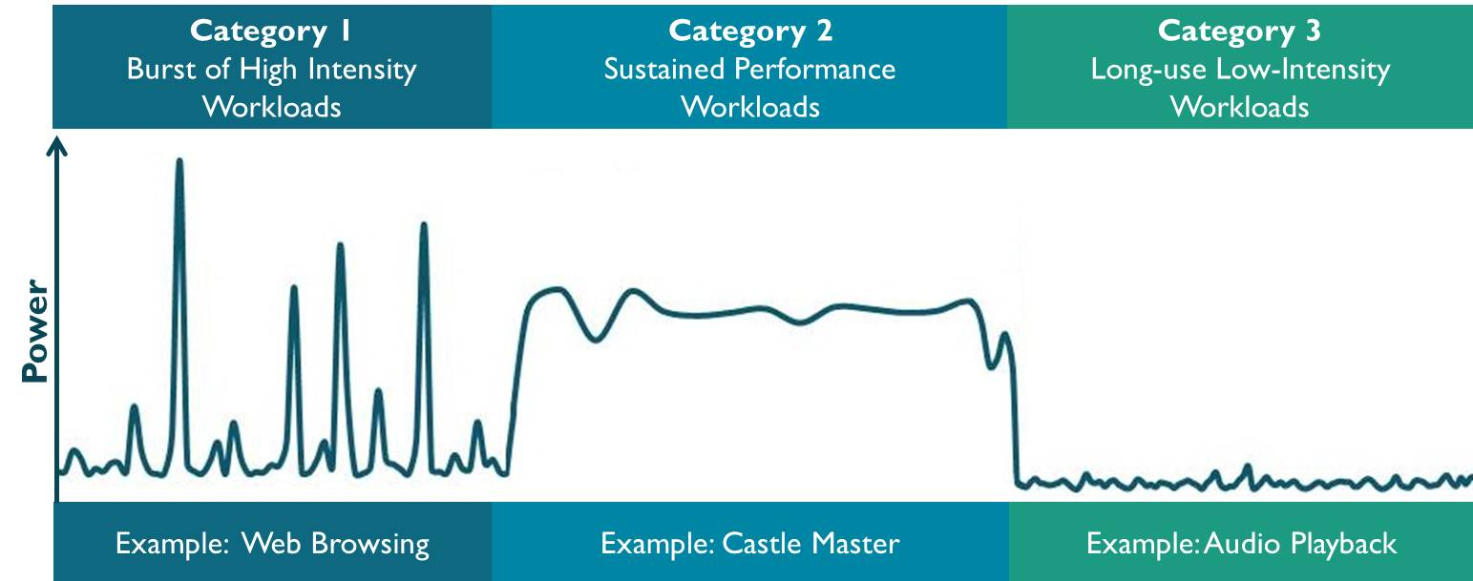
Which workload do mobile apps have?

Slide 51
Network Contention Trade-offs and UX
Finish connection A before starting B to keeps UI responsive
But.. TCP throttles up bandwidth use slowly per connection
The roundtrip latency of starting connection B after A ends is dead air
Unless you start B while A is still ongoing
Precise, measure B onset time based on tuned filter prediction of past connection latency to a given server and tuned filter predicted A end time is possible. It has be done… but perhaps not worth it except on 2G
Simpler: have 1 more connection than you need, let chaos solve it
Total memory load
Too many concurrently downloading byte arrays causes peak resource load

Slide 52
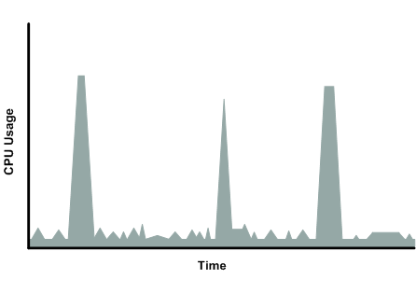
Why do you care that it is mostly spikes?
4-8 cores all working makes the spike narrower
Narrow spikes -> UX
Narrow spikes -> power savings
Sequence first things first
Tasks not visible to users can be between spikes
So: less contention with UX during the spike

Slide 53
How many threads should you light up?
UI
One thread to rule them all, one thread to..
WORKER
Same as core count
FLASH
READ: one (writes are cached, jump past queue)
WRITE: one (per flash device, depending on hardware)
NET
READ
2G: 2
3G: 3
4G & WIFI: 4
WRITE
Just 1
Asymmetric. You want to finish A before starting B

Slide 54
Iterate, RX, Cascade
Iterable pull
RX
Cascade functional
Cascade reactive
T next()
throws E
(+ plumbing)
.onNext(T)
.onError(T)
.onCompleted()
(+ plumbing)
(+ baked methods)
(+ cleanup)
.then(t -> f(T))
or
.then(t -> R f(T))
.onError(e -> f(E)
or
.onError((e, T) -> f(E, T)
AltFuture.fork()
SettableAltFuture.set(T)
.subscribe(t -> f(T))
or
.subscribe(t -> R f(T))
.onError(e -> f(E)
or
.onError((e, T) -> f(E, T)
AtomicValue.set(T)
ReactiveTextView.subscribe(String)

Slide 55
Iterate, RX, Cascade
- Finite sequence
- Infinite stream
- Finite sequence
- Infinite stream
- Finite sequence
- Infinite stream
Iterable pull
RX
Cascade functional
Cascade reactive
T next()
throws E
(+ plumbing)
.onNext(T)
.onError(T)
.onCompleted()
(+ plumbing)
(+ baked methods)
(+ cleanup)
.then(t -> f(T))
or
.then(t -> R f(T))
.onError(e -> f(E)
or
.onError((e, T) -> f(E, T)
AltFuture.fork()
SettableAltFuture.set(T)
.subscribe(t -> f(T))
or
.subscribe(t -> R f(T))
.onError(e -> f(E)
or
.onError((e, T) -> f(E, T)
AtomicValue.set(T)
ReactiveTextView.subscribe(String)

Slide 56
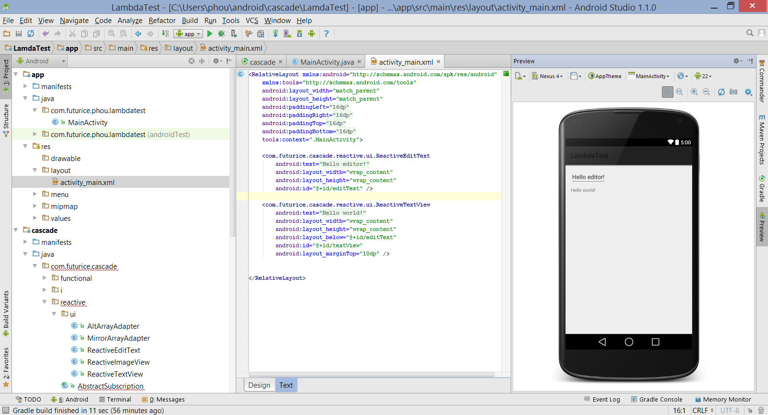

Slide 57
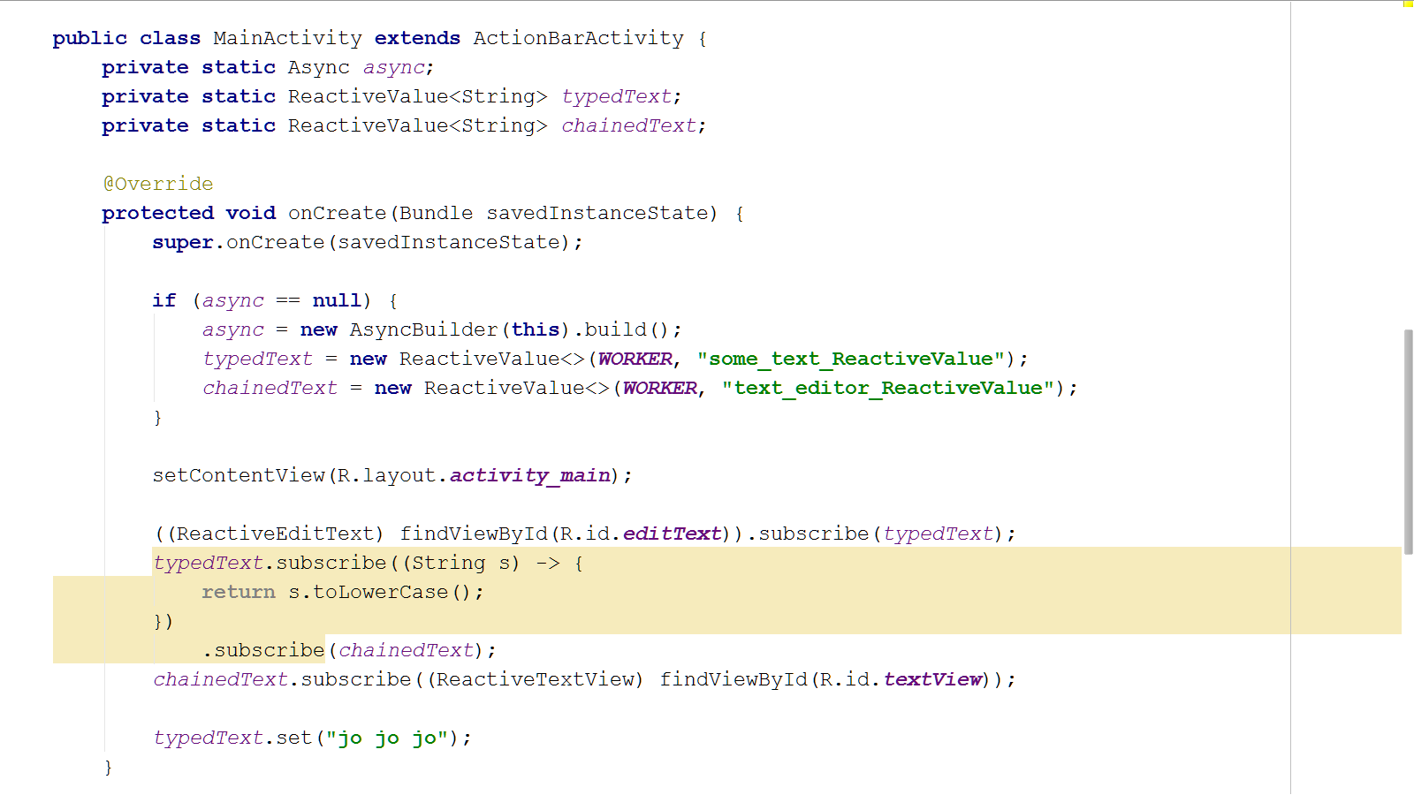

Slide 58
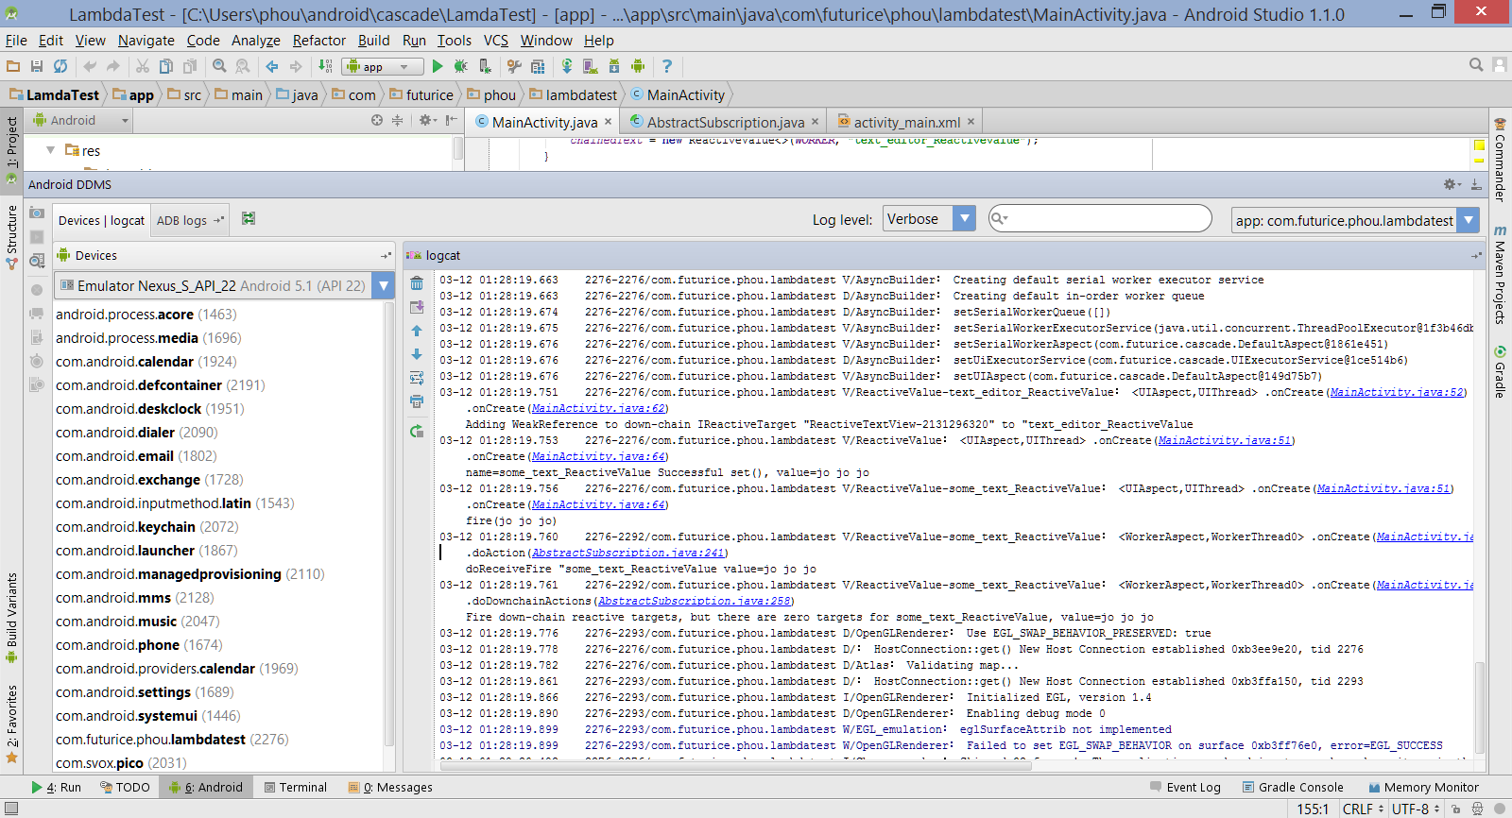

Slide 59
What Next?
MirrorService
REST with reactive concurrent set logic
MVVM example:
restWebServer.subscribe((JSON item) -> {
return parse(item);
}
.subscribe(model)
.subscribe((String item) -> {
return item.contains(filter); // Filter is a reactive AtomicValue<String>
}
.subscribe(filteredViewModel);

Slide 60
What Next?
Internet of Things cross-device closed loop lambda throw
Throw lambda logic to a device nearby
Wearable example:
restWebServer.subscribe((JSON item) -> {
return parse(item);
}
.subscribe(commandModel)
.subscribe(WATCH, (String item) -> {
return myWatch.process(item);
}
.subscribe(watchCommandResultsModel);

Slide 61
What Next?
Information-centric network local resolution and actuators
Throw/receive lambda logic to/from devices by name (not net location)
Sensor example:
icn(“airTemperature”).subscribe((float temp) -> {
return threeMinuteRollingAverage(temp);
}
.subscribe((float average) -> {
system.println(“Nearby it is “ + average);
}
.subscribe(average ->
icn(“bigScreenDisplay”).post(average))
.onError(() ->
icn(“bigScreenDisplay”).post(“Problem getting temperature”);

Slide 62
What Next?
Web app integration with local and remote POST services
GET, PUT, POST, DELETE by URL
Image repository example:
PostService.resolve(“http://stocks.com/api?ticker=msft”).subscribe((JSON priceJson) -> {
…
}

Slide 63
Github
https://github.com/paulirotta/cascade
“No future but what we make” –John Connor, Terminator
“Men have become the tools of their tools” –Henry David Thoreau
“An apprentice carpenter may want only a hammer and saw, but a master craftsman employs many precision tools.

Slide 64

Or be common, follow the herd..

Slide 65

Developers take their tools into battle..

Slide 66

..and the result are predictable
Developers go into battle
..with predicable results

Slide 67
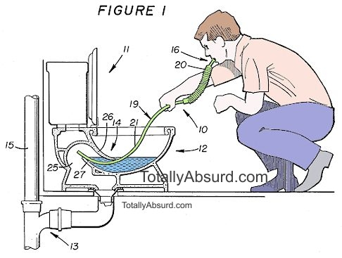

Slide 68
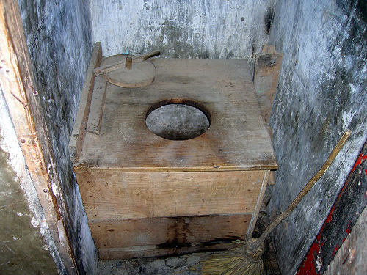

Slide 69
